Slide 1
Decode Java+DSA

Slide 2
Chapter 1 : Basics
Output
Variables & Operators
Variable naming rules
Comments
Input
Modulus Operator
Typecasting
Hierarchy
Char and ASCII

Slide 3
IntelliJ Idea and JDK

Slide 4





Basic program in Java
public class FirstProgram{
public static void main(String args[]){ System.out.print(“Hello World”);
}
}

Slide 5

How to move in next line?
Example :
System.out.print(“Hello PW”); System.out.print(“Hello CW”);
Output will be :
Hello PWHello CW

Slide 6
How to move in next line?
Example :
System.out.println(“Hello PW”); System.out.print(“Hello CW”);
Output will be : Hello PW Hello CW

Slide 7


Variables and their Declaration
Let us focus on int data type as of now.
1) Variables as containers :

Slide 8
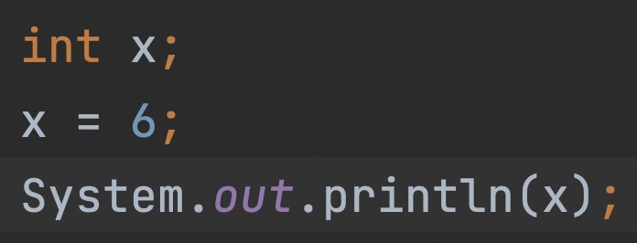



Slide 9
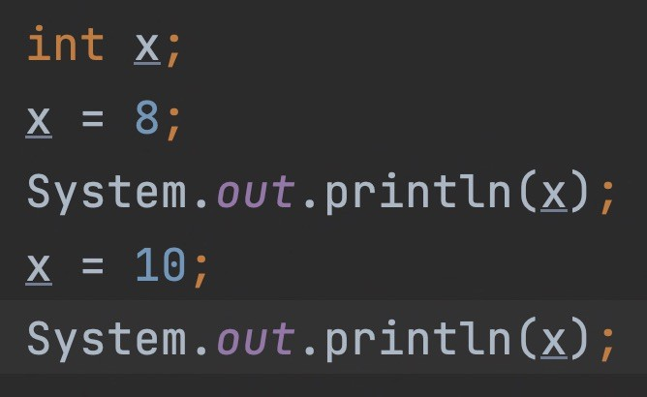








Slide 10















Printing Variables & Updation of Variables
int x = 5; System.out.println(x); x = 7;
System.out.println(x); x = x + 6; System.out.println(x); x = x - 20;
System.out.println(x);

Slide 11







Arithmetic operations on int data type
int x = 5;
int y = 2; System.out.println(x+y); System.out.println(x-y); System.out.println(x*y); System.out.println(x/y); / issue

Slide 12
Increment - Decrement operators
int x = 5;
x +; System.out.println(x); x -; System.out.println(x);
+x; System.out.println(x); –-x;
System.out.println(x);

Slide 13

double & float data type
double x = 3.1;
float f = 2.87f;

Slide 14

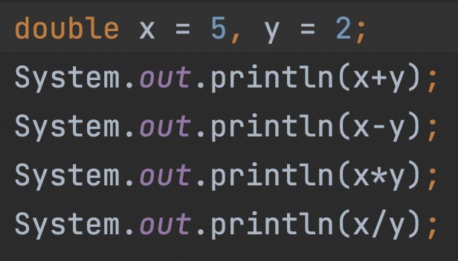
Arithmetic operations on float data type
float x = | 5;
float y = | 2;
cout <x+y | <endl;
cout <x-y | <endl;
cout <x*y | <endl;
cout <x/y | <endl;

Slide 15







Example : Calculating Area of a Circle

Slide 16
Homework : Calculate Volume of a Sphere

Slide 17









Example : Calculating Simple Interest

Slide 18
Variable Naming rules
Variables can start from an alphabet or underscore _ or $ .
Special characters except _ and $ are not allowed.
Some particular keywords are not allowed.
Commas or blanks are not allowed.
auto | double | int | break | extern | enum | unsigned | while
case | sizeof | for | const | static | long | continue | float
else | signed | do | short | switch | char | volatile | default
goto | struct | if | union | return | void | register | typedef

Slide 19
Variable Naming rules - Examples
q. Which of the following are invalid variable names and why?
BASICSALARY
#MEAN
_basic
group. over time hELLO
Plot#3
basic-hra
422
mindovermatter queue.
2015_DDay
population in 2006
FLOAT
team’svictory

Slide 20
Taking input // Square of a Number

Slide 21
Take 2 numbers input from user and print their Sum

Slide 22










Modulus Operator

Slide 23












Modulus Operator

Slide 24



Typecasting
ques : Take integer ‘x’ as input and print half of the number.

Slide 25








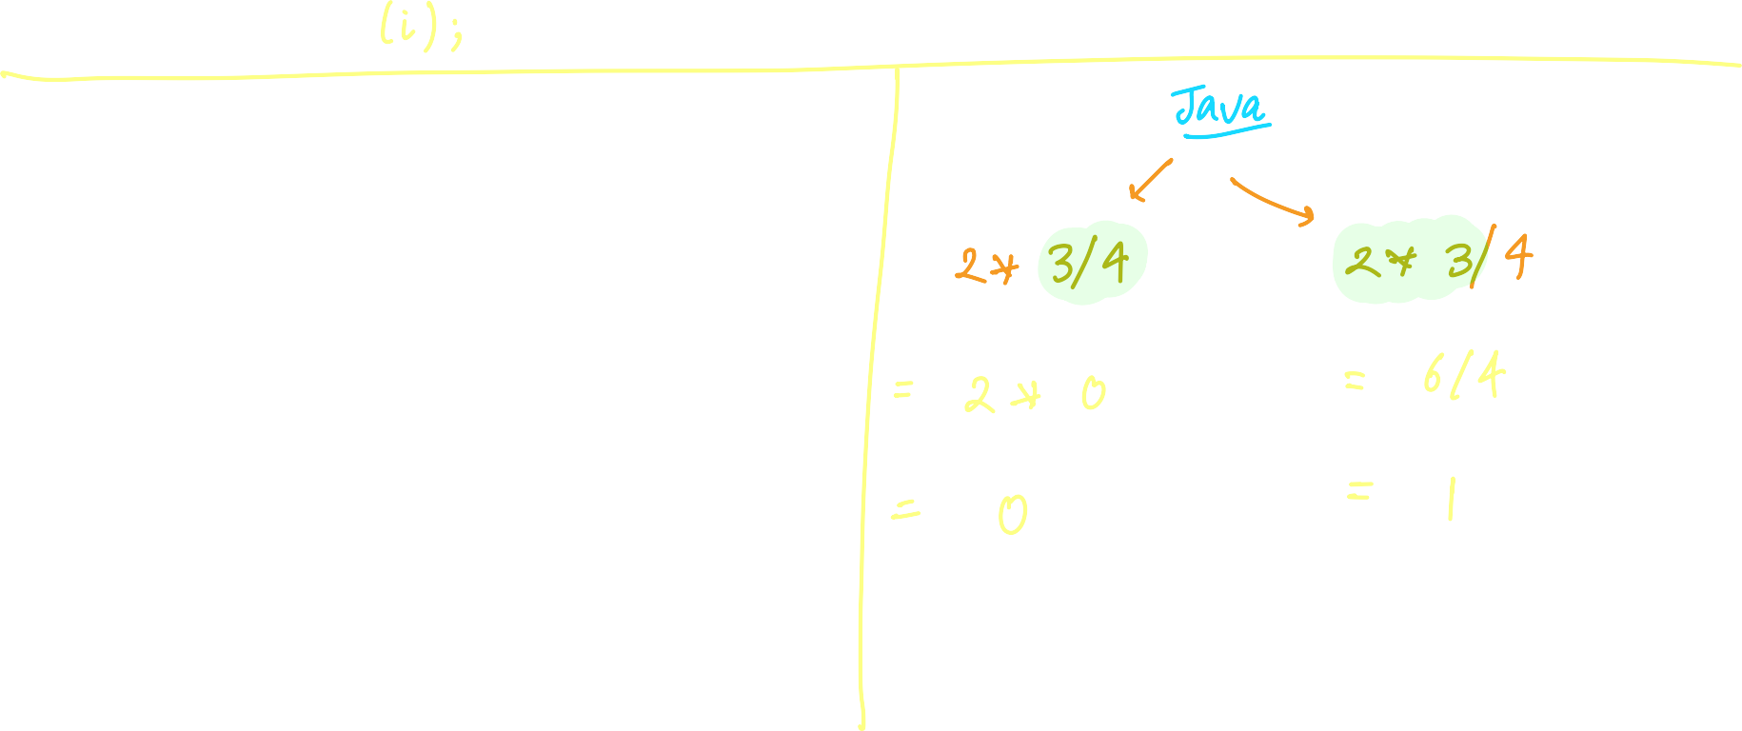





Hierarchy of operators
int i = 2 * 3 / 4 ;
cout <i;

Slide 26











int/int , int/double, double/int, double/double

Slide 27
char data type
char ch = ‘a’;

Slide 28





ASCII values
char ch = ‘a’;

Slide 29
MCQ Time !

Slide 30
Homework
In b = 6.6 / a + 2 * n ; which operation will be performed first?
6.6 / a
a + 2
2 * n
Depends upon compiler

Slide 31

Which of the following statements is false
MCQ
Each new Java instruction has to be written on a separate line
Usually all Java statements are entered in small case letters
Blank spaces may be inserted between two words in a Java statement
Blank spaces cannot be inserted within a variable name

Slide 32
Homework
The expression, double a = 7 / 22 * ( 3.14 + 2 ) * 3 / 5 ; evaluates to
(1) 8.28
(2) 6.28
(3) 3.14
(4) 0

Slide 33





The expression int x = 4 + 2 % - 8 evaluates to
MCQ
(1) -6
(2) 6
(3) 4
(4) None of the above

